Slide 1
C++ Revision

Slide 2
Include Directives
#include <iostream>
Preprocessor directive
iostream is a library containing definitions of the input and output function
Linker
Appears at the start of the program, begin with #
using namespace std;
Tells the compiler to use names in iostream in a “standard” way

Slide 3
int main()
{ //beginning of the main function
.... //statements
return 0;
} //end of the program

Slide 4
The output function cout
c(C++ language)out(output)
c(C++ language)in(input)
cout<<whatever data you want to output;
cout<<“Welcome to CMPT238!”;
<< represents the flow of the data.

Slide 5
Input Function cin
cout: output to screen
cin: input from keyboard
cout<<whatever you want to output;
cin>>variable_name;
cin>>variable1>>variable2;
Or cin>>variable1;
cin>>variable2;

Slide 6
Escape sequences
Start a new line
\n (need to go inside of the quotes)
endl
Escape sequence
\n new line
\t tab
\” ”
\\ \

Slide 7
Comments
// This is a comment.
/*
This is a comment.
This is another comment.
*/

Slide 8
Combine Declaration and Assignment
int number = 3;
double rate = 0.07, balance = 0;

Slide 9
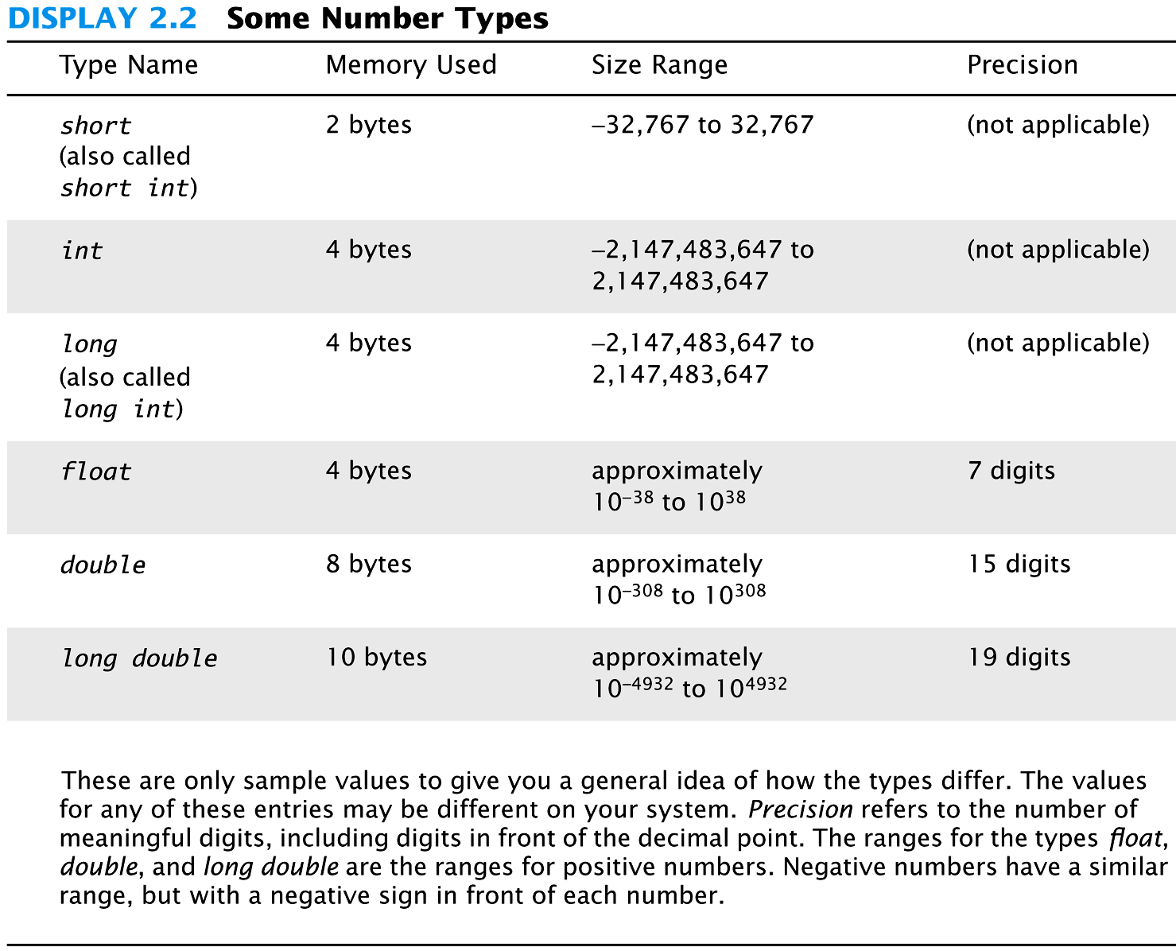
http://software.intel.com/en-us/articles/size-of-long-integer-type-on-different-architecture-and-os

Slide 10
The char Type
Short for character
Any single character from the keyboard
a letter, a digit, or punctuation mark
int number; char letter;
int number = 5; char letter = ‘a’;
char letter = ‘A’;

Slide 11
The Class string
#include <string>
char letter; string message;
char letter = ‘a’; string message = “hello”;
Concatenation
string firstName = “Joe”;
string lastName = “Smith”;
string name = firstName + lastName;
//string name = firstName + “ “ + lastName;

Slide 12
The bool Type
Boolean
Two values
True
False
bool flag;
bool isPrime = false;

Slide 13
Constants
double pi = 3.14159;
const double PI = 3.14159;
const double CELSIUS_TO_FAHRENHEIT = 33.8;

Slide 14
Arithmetic Operators
+, -, *, /
int / int -> int
double / int -> double
10/3, 5/2, 11/3

Slide 15
Modulus %
17 % 5 = 2
23 % 2 = ?
20 % 3 = ?
How to determine if a number is even/odd?

Slide 16
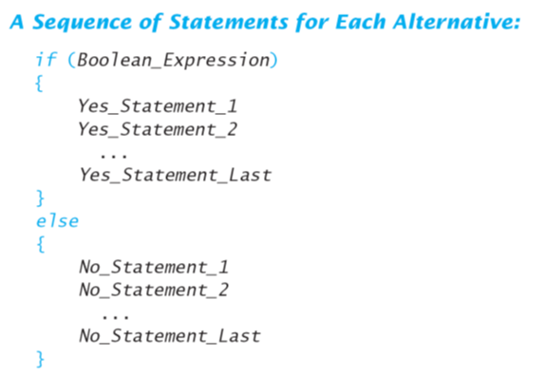

Slide 17
Multiway if-else syntax
if (condition_1)
Action_1;
else if (condition_2)
Action_2;
...
else if (condition_N)
Action_N;
else
Action_For_All_Other_Cases;

Slide 18
Comparison Operators
> greater than
< less than
>= greater than or equal to
<= less than or equal to
== equal to
!= not equal to
a = 2;
if (a == 2)

Slide 19
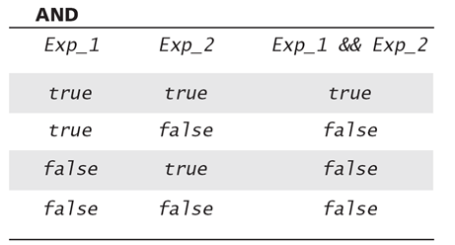
The And Operator
If score is greater than 0 and less than 100...
(score > 0) && (score < 100)
is true only if both are true

Slide 20
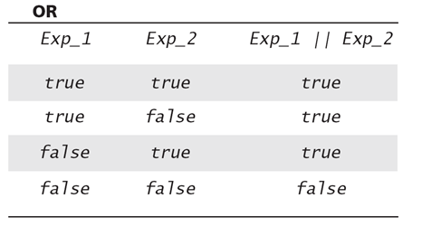
The Or Operator
(score1 >= 60) || (score2 >= 60)
is true if one or both are true

Slide 21
Syntax of the while Statement
while (Boolean_Expression)
{
Statement_1; // body
Statement_2; // iteration
...
}
while (Boolean_Expression)
Statement;

Slide 22
For Loop Dissection
The for loop uses the same components as the while loop in a more compact form
for (int n = 1; n <= 10; n++)
Initialization Action
Update Action
Boolean Expression

Slide 23
Nested Loops
for (int i = 1; i <= 5; i++)// outer loop
{
for (int j = 1; j<=5; j++)// inner loop
{
cout<<i<<“ “<<j<<endl;
}
}

Slide 24
The break Statement
The break statement can be used to exit a loop.

Slide 25
The continue Statement
Can use continue to go to end of loop and prepare for next repetition

Slide 26
Exercise: Pattern Displays
Write a C++ program that uses a loop to display the pattern below.
++++++++++
+++++++++
++++++++
+++++++
++++++
+++++
++++
+++
++
+

Slide 27
Random Number Generation
Really pseudo-random numbers
R_{i} = (R_{i-1} * 7) % 11
1. Seed the random number generator only once
#include <cstdlib>
#include <ctime>
srand(time(0));
2. The rand() function returns a random integer that is greater than or equal to 0 and less than RAND_MAX (32767);

Slide 28
Random Numbers
Use % and + to scale to the number range you want
Generate a random number from 0-99
int num = rand() % 100;
Generate a random number from 1-6
int die = (rand() % 6) + 1;
Generating a random number x where 10<=x<=20?
To limit the range of random numbers generated, the following approach should be used
y = (rand() % (maxValue – minValue + 1) + minValue where minValue – the lowest number in the range and maxValue – the highest number in the range

Slide 29
User-Defined Functions
Function declaration
Type Function_Name(Type Parameter);
int product(int x, int y);
Function definition
Type Function_Name(Type Parameter) { //code }
int product(int x, int y) // function header
{
int result = x * y;
return result;
}

Slide 30
The Function Call
int main()
{
int number = product (5, 6);
...
}
int product(int x, int y)
{
int result = x * y;
return result;
}

Slide 31
Overloaded Functions
double ave(double n1, double n2) { return ((n1 + n2) / 2); }
double ave(double n1, double n2, double n3) { return (( n1 + n2 + n3) / 3); }
Which one are we calling? cout << ave( 10, 20);
cout << ave( 10, 20, 30);

Slide 32
void Functions
int square (int number)
{
return number * number;
}
void print_number (int number)
{
cout<<“The number is “<<number;
}

Slide 33
Calling a void-Function
void print_number (int number)
{
cout<<“The number is “<<number;
}
void-function calls are executable statements.
int main()
{
print_number(10); // Correct
cout<<print_value(10); // Wrong!
...
}

Slide 34
Call-by-Value
int square (int n)
{
n = n * n;
return n;
}
int main ()
{
int number = 10;
int result = square(number);
cout<<result<<“ “<<number;
}

Slide 35
Call-by-Reference
void get_value (int& n)
{
cout<<“Enter an integer: “;
cin>>n;
}
int main ()
{
int number = 0;
get_value(number);
...
}

Slide 36
Declaring an Array
An array, named scores, containing 100 variables of type int can be declared as int scores[100];
e.g.,
char characters[50];

Slide 37
How to access array elements?
Array indices are 0-based.
E.g., indices in scores are from 0 to 99.
Syntax (indexed variable):
arrayName[index]
Example:
scores[0]
scores[1]
scores[99] // scores[size-1]

Slide 38
Loops And Arrays
for-loops are commonly used to step through arrays
Example: for (int i = 0; i < 100; i++) { scores[i] = 100; }
for (int i = 0; i < 100; i++)
{
cin>>scores[i];
}
First index is 0
Last index is (size – 1)

Slide 39
Passing Entire Array to Functions
int find_sum(int a[ ], int size);
int main()
{
int scores[20];
int average = find_sum (scores, 20);
}

Slide 40
const Array Argument
When we use an array argument in a function call, the function can change the values in the array.
An array can not be modified with a const.
int find_average(const int a[ ], int size);

Slide 41
Exercises
Write a function that calculates the average of an array, where the lowest element in the array is dropped.
int getAverage(const int array[], int size)

Slide 42
Getting the Address of a Variable
Each variable in program is stored at a unique address
Use address operator & to get address of a variable:
int num = -99;
cout << &num; // prints address
// in hexadecimal

Slide 43
Pointer Variables
Pointer variable : Often just called a pointer, it's a variable that holds an address
Because a pointer variable holds the address of another piece of data, it "points" to the data

Slide 44
Pointer Variables
Definition:
int *intptr;
Read as:
“intptr can hold the address of an int”

Slide 45
The Indirection Operator
The indirection operator (*) dereferences a pointer.
It allows you to access the item that the pointer points to. int x = 25; int *intptr = &x; cout << *intptr << endl;
This prints 25.

Slide 46
Dynamic Memory Allocation
Can allocate storage for a variable while program is running
Uses new operator to allocate memory:
int size;
cout<<“What is the size? “;
cin>>size; int *arrayPtr = new int[size];

Slide 47
Address of the variable
Let us declare another variable to hold the memory address of variable num
Let say gives it a name, numPtr int *numPtr;
Memory address
1000
1001
1002
1003
1004
1005
?
7
Second variable
numPtr
num

Slide 48
Pointer
Let’s assign the address of the variable num to pointer variable numPtr numPtr = &num;
*numPtr
1000
1001
1002
1003
1004
1005
1003
7
numPtr
num

Slide 49
Pointer
Graphical explanation of a pointer
int num = 7;
int *numPtr;
numPtr = &num;
numPtr
num
7

Slide 50
The idea of pointers
Assume: value1 and value2 are declared as integers and initialized to the values of 10 and 20. p1 and p2 are defined as pointers
&value1 and &value2 represents memory addresses of the variables
&value1 points to the box containing the integer 10
&value2 points to the box containing the integer 20
p1
value1
10
&value1
p2
value2
20
&value2

Slide 51
The idea of pointers
p1 and p2 are pointer variables
We can assign them at any time to point to data in the computer memory
p1 = &value1;
p2 = &value2;
p1
value1
10
&value1
p2
value2
value2
20
&value2

Slide 52
The idea of pointers
We can assign p1 to p2
p2 = p1;
Now, p1, p2, and &value1point to the value 10.
p1 and p2 are pointer variables
p1
value1
10
&value1
p2
value2
20
&value2

Slide 53
Pointer Variables
Definition:
int *intptr;
Read as:
“intptr can hold the address of a variable whose type is int”
Spacing in definition does not matter:
int * intptr; // same as above
int* intptr; // same as above

Slide 54
Pointer declaration
Syntax of a pointer declaration
Type_specifier * identifier
A compiler must know what type of data the pointer is pointing to first
Example:
int *IntPointer
The variable IntPointer is a pointer to an integer
The asterisk * in front of IntPointer instructs the compiler that IntPointer is a pointer variable pointing to an integer, but not a variable of type integer

Slide 55
Pointer declaration
These are three declarations of pointers. Each one is intended to point to a different data type
int * Integer_Pointer;
char * Character_Pointer;
double * Float_Pointer;
In fact, all of them are pointers and all of them occupy the same amount of space in memory (the size in memory of a pointer depends on the platform where the program runs)

Slide 56
Pointer declaration
int * Integer_Pointer;
char * Character_Pointer;
double * Float_Pointer;
all of them are pointers and all of them occupy the same amount of space in memory (the size in memory of a pointer depends on the platform where the program runs)
Nevertheless, the data to which they point to do not occupy the same amount of space nor are of the same type: the first one points to an int, the second one to a char, and the last one to a double

Slide 57
Pointer and Dereference Operator
The * is used in two different contexts
1) for declaration a variable as a pointer
Example int *yPtr;
here *yPtr is used to declare a pointer
2) to access to a value, which is pointed by a pointer
Example cout << *yPtr;
here *yPtr is used as a dereference operator to access a variable stored in the address contained in yPtr

Slide 58
Pointer and dereference operator
The dereference operator * can be read and understood as “a value pointed to by"
Therefore, the last statement of the following sequence:
int num=7;
int *numPtr;
numPtr = &num;
baz = *numPtr;
could be read as: "baz equal to the value pointed to by numPtr“

Slide 59
Pointer and dereference operatorr
Since numPtr points to the memory location containing 7, then after
baz = *numPtr;
baz becomes equal to 7
*numPtr
1000
1001
1002
1003
1004
1005
1003
7
7
numPtr
num
baz

Slide 60
Pointer and Dereference Operator
Thus the asterisk (*) used when declaring a pointer only means that it is a pointer (it is part of its type compound specifier)
It should not be confused with the dereference operator, which is also written with an asterisk (*)
They are simply two different things represented with the same sign

Slide 61
The Dereference (Indirection) Operator
The dereference (indirection) operator (*) dereferences a pointer
It allows you to access the item that the pointer points to: int x = 25; int *intptr = &x; cout << *intptr << endl;
This prints 25.

Slide 62
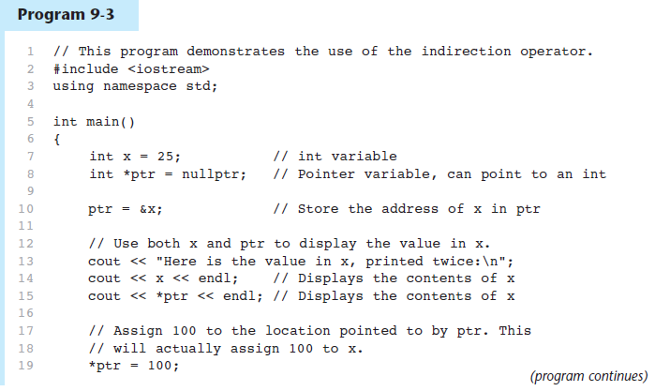
The Dereference (Indirection) Operator in Program 9-3

Slide 63
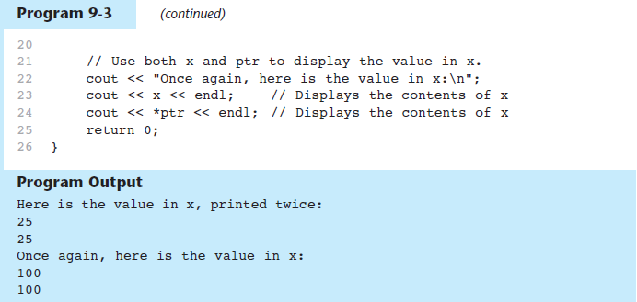
The Dereference (Indirection) Operatorin Program 9-3

Slide 64
Exercise 1
Design a program, which should prompt the user to enter two integers and then swap their values using pointers and the dereference operator

Slide 65
Pointer Operators
#include <iostream>
using namespace std;
int main(void)
{
int a; /* a is an integer */
int *aPtr; /* aPtr is a pointer to an integer */
a = 7;
aPtr = &a; /* aPtr set to address of a */
cout << "The address of a is “ << &a <<
"\nThe value of aPtr is “ << aPtr ;
// &a and aPtr have the same value
char x; // declaration of variable x as a character
cin >> x; // entering a value of x from a keyboard
return 0;
}

Slide 66
Pointer Operators
#include <iostream>
using namespace std;
int main(void)
{
int a; /* a is an integer */
int *aPtr; /* aPtr is a pointer to an integer */
a = 7;
aPtr = &a; /* aPtr set to address of a */
cout << "Showing that * and & are complements of each other:\n” << “&*aPtr = “ << &*aPtr << “\n*&aPtr = “ << *&aPtr );
return 0;
}

Slide 67
Exercise 2
Write a program that asks the user to enter integers as inputs to be stored in the variables 'a' and 'b' respectively. There are also two integer pointers named ptrA and ptrB. Assign the values of 'a' and 'b' to ptrA and ptrB respectively, and display them.

Slide 68
Consider the following statements:
int *p;
int i;
int k;
i = 42;
k = i;
p = &i;
After these statements, which of the following statements will change the value of i to 75?
k = 75;
*k = 75;
p = 75;
*p = 75;
Two or more of the answers will change i to 75.

Slide 69
Pointer Variables Initialization
You may initialize pointer variables with the special value nullptr
In C++ 11, the nullptr key word was introduced to represent the address 0
Here is an example of how you define a pointer variable and initialize it with the value nullptr:
int *ptr = nullptr;

Slide 70
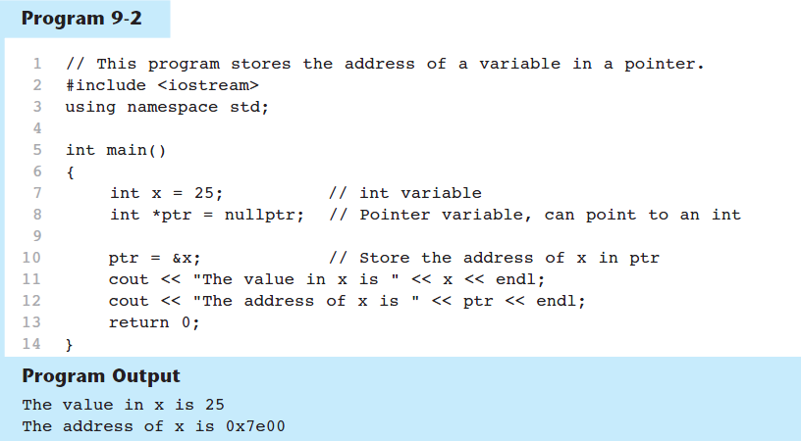
A Pointer Variable in Program 9-2

Slide 71
Initializing Pointers
Can initialize at definition time:
int num, *numptr = &num;
int val[3], *valptr = val;
Cannot mix data types:
double cost;
int *ptr = &cost; // won’t work
Can test for an invalid address for ptr with:
if (!ptr) ...

Slide 72
Initializing a pointer to point to a value
There are two ways to initialize a pointer to point to a value
1. Allocating memory statically by defining a variable and then making the pointer point to the variable value
2. Allocating memory dynamically and initializing the pointer to point to a value

Slide 73
Initializing a pointer to point to a value – Static memory allocation
Once the variable is defined, the compiler reserves enough memory to store a value of the given data type
This memory remains reserved for this variable and can’t be used for anything else during the program execution – can’t deallocate the memory
The pointer to that variable can be changed, but the amount of memory reserved for the variable remains unchanged

Slide 74
Initializing a pointer to point to a value
Static memory allocation
int *p1;
int value;
p1 = &value; //p1 point to the variable called value
*p1 = 25; //store value 25 in memory where p1 is pointing to
Last assignment (*p1 = 25;) means that it stores the value 25 in the contents of memory to where p1 is pointing
This is the same memory location as &value
We can say that *p1 is an alias for the variable value

Slide 75
Pointer Arithmetic
Operations on pointer variables:
Operation | Example int vals[]={4,7,11}; int *valptr = vals;
++, -- | valptr++; // points at 7 valptr--; // now points at 4
+, - (pointer and int) | cout << *(valptr + 2); // 11
+=, -= (pointer and int) | valptr = vals; // points at 4 valptr += 2; // points at 11
- (pointer from pointer) | cout << valptr–val; // difference //(number of integers) between valptr // and val

Slide 76
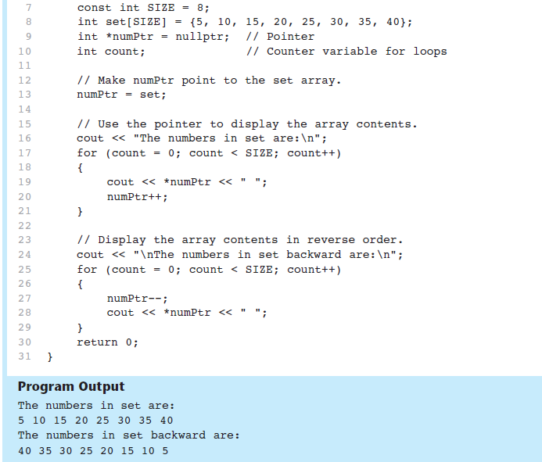
From Program 9-9

Slide 77
9.3
The Relationship Between Arrays and Pointers

Slide 78
The Relationship Between Arrays and Pointers
Array name is starting address of array
int vals[] = {4, 7, 11};
cout << vals; // displays
// 0x4a00
cout << vals[0]; // displays 4
4 | 7 | 11
starting address of vals: 0x4a00

Slide 79
The Relationship Between Arrays and Pointers
Array name can be used as a pointer constant:
int vals[] = {4, 7, 11};
cout << *vals; // displays 4
Pointer can be used as an array name:
int *valptr = vals;
cout << valptr[1]; // displays 7

Slide 80
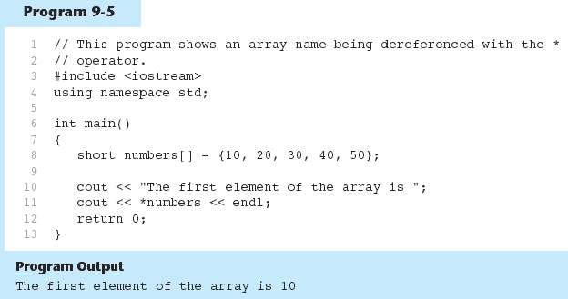
The Array Name Being Dereferenced in Program 9-5

Slide 81
Array Access
Array elements can be accessed in many ways:
Array access method | Example
array name and [] | vals[2] = 17;
pointer to array and [] | valptr[2] = 17;
array name and subscript arithmetic | *(vals + 2) = 17;
pointer to array and subscript arithmetic | *(valptr + 2) = 17;

Slide 82
Array Access
Conversion: vals[i] is equivalent to *(vals + i)
No bounds checking performed on array access, whether using array name or a pointer

Slide 83
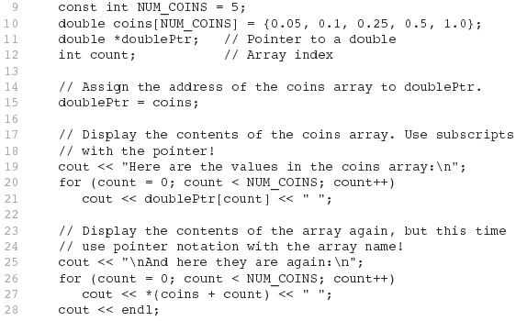

From Program 9-7

Slide 84
Pointer and Array
When an array is declared, the name of the array is actually a pointer to the first element in the array. As a consequence, array parameters are always passed to a function by reference
table[6] = {16, 21, 8, 3, -7, 9};
→ This is the same as following:
*(table + 0) = 16; // or table[0] = 16; *(table + 1) = 21; // or table[1] = 21; *(table + 2) = 8; // or table[2] = 8; *(table + 3) = 3; // or table[3] = 3; *(table + 4) = -7; // or table[4] = -7; *(table + 5) = 9; // or table[5] = 9;
Therefore, *(table + i) is the same as the table[i], where i = 0 to 5

Slide 85
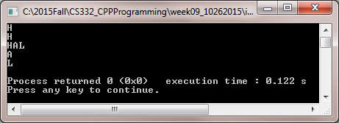
Accessing Pointer Data
#include <iostream>
using namespace std;
int main()
{
char a[4] ="HAL";
cout << a[0] << "\n"; //display 0th element of an array
cout << *a << "\n"; //a is a character array. it prints 'H' which is // first element of an array
cout << a; //a is a pointer to an array of characters
cout << "\n";
cout << *(a+1) << "\n";
cout << *(a+2) << "\n";
return 0;
}

Slide 86
Exercises
Write a C++ program to find the max of an integral data set. The program will ask the user to input the number of data values in the set and each value. The program prints on screen a pointer that points to the max value.

Slide 87
Exercises
Write a program in C to demonstrate the use of &(address of) and *(value at address) operator. Expected Output :
Pointer : Demonstrate the use of & and * operator :
--------------------------------------------------------
m = 300
fx = 300.600006
cht = z
Using & operator :
-----------------------
address of m = 0x7ffda2eeeec8
address of fx = 0x7ffda2eeeecc
address of cht = 0x7ffda2eeeec7
Using & and * operator :
-----------------------------
value at address of m = 300
value at address of fx = 300.600006
value at address of cht = z
Using only pointer variable :
----------------------------------
address of m = 0x7ffda2eeeec8
address of fx = 0x7ffda2eeeecc
address of cht = 0x7ffda2eeeec7
Using only pointer operator :
----------------------------------
value at address of m = 300
value at address of fx= 300.600006
value at address of cht= z

Slide 88
Exercises
- Write a program in C to add two numbers using pointers.
Test Data :
Input the first number : 5
Input the second number : 6
Expected Output :
The sum of the entered numbers is : 11
- Write a program in C to add numbers using call by reference.
Test Data :
Input the first number : 5
Input the second number : 6
Expected Output :
The sum of 5 and 6 is 11

Slide 89
Dynamic Memory Allocation
Can then use [] to access array:
for(i = 0; i < SIZE; i++)
arrayPtr[i] = 100;

Slide 90
Releasing Dynamic Memory
Use delete to free dynamic memory:
delete[] arrayPtr;

Slide 91
Class Circle Definition
class Circle { private: double radius; //member variable
public:
double getArea( ); //member function };

Slide 92
Defining a Member Function
double Circle::getArea() { double area = 3.14 * radius * radius;
return area; }
‘::’ is the scope resolution operator.

Slide 93
How to create an object?
You can create many objects of a class in the main function.
Circle c;

Slide 94
Calling Member Functions
Syntax: Object. Member_Function
Example:
circle1.getArea( ); circle2.getArea( );

Slide 95
Constructors
Circle()
{
radius = 1;
}
A constructor is usually public.
A constructor must have the same name as the class.
Constructors do not have a return type (not even void).
Constructors play the role of initializing objects.

Slide 96
Calling A Constructor
A constructor is called in the object declaration. Circle c;
Circle()
{
radius = 1;
}

Slide 97
Destructors
Member function automatically called when an object is destroyed
Destructor name is ~classname, e.g., ~Circle()
Has no return type; takes no arguments
If constructor allocates dynamic memory, destructor should release it

Slide 98
Pointer to an Object
Can define a pointer to an object:
Circle *circlePtr = new Circle;
Can access public members via pointer:
circlePtr->setRadius(10);
cout << circlePtr->getArea();
delete circlePtr;

Slide 99
Exercises: The Car class
Create a Car class that contains the following
yearModel: an int that holds the car’s year model
make: a string that holds the make of the car
speed: an int that hold the car’s current speed
A constructor that accepts the car’s year model and make as arguments. The constructor should assign 0 to speed.
getSpeed()
accelerate(int) that adds the argument to speed
brake(int) that subtracts the argument from speed

Slide 100
Structures
Structures are from C.
C structures are the C++ classes without any member functions.
struct Person
{
string name;
string phoneNumber;
string email;
};

